Slide 1
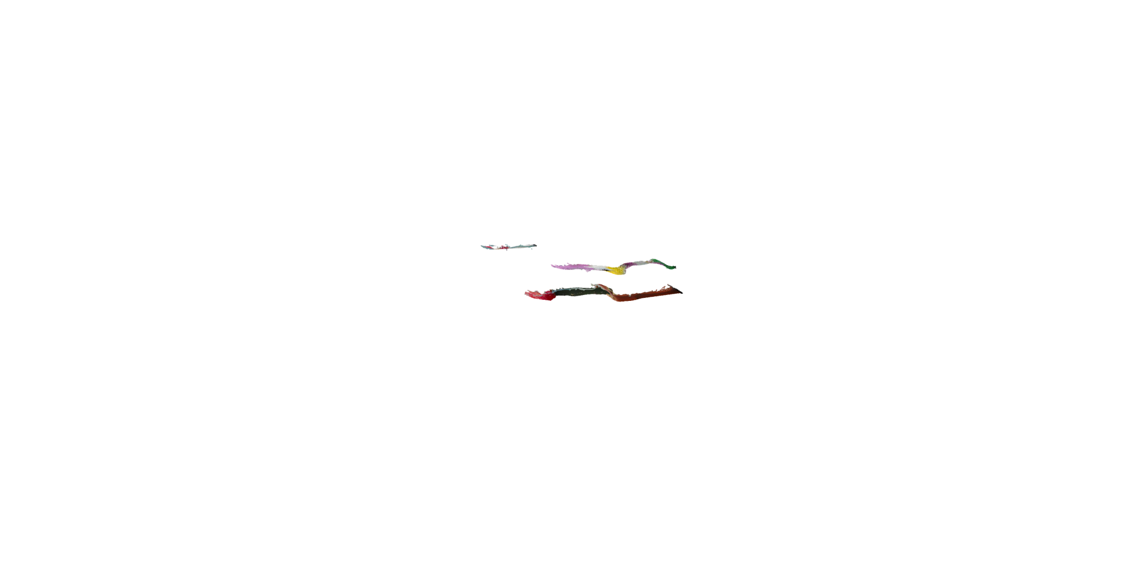
WRP 1
N(z₁) = 2
Depth
Range 1
WRP 2
N(z₂) = 1
N(z₃) = 6
Depth
Range 2
N(z₄) = 8
N(z₅) = 1
WRP 3
N(z₆) = 2
Depth
Range 3
N(z₇) = 4
N(z₈) = 3
Hologram plane

Slide 2
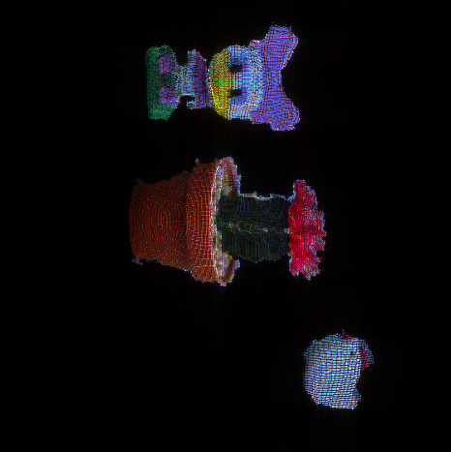
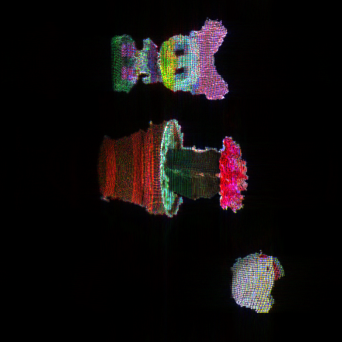
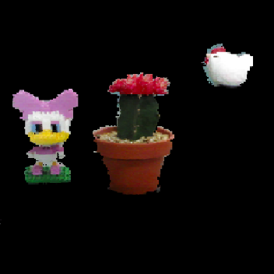
WRP 1
N(z₁) = 2
Depth
Range 1
N(z₂) = 1
WRP 2
N(z₃) = 6
Depth
Range 2
N(z₄) = 8
N(z₅) = 1
WRP 3
N(z₆) = 2
Depth
Range 3
N(z₇) = 4
N(z₈) = 3
Hologram plane
(a)
(a)
(b)
(c)
(d)

Slide 3
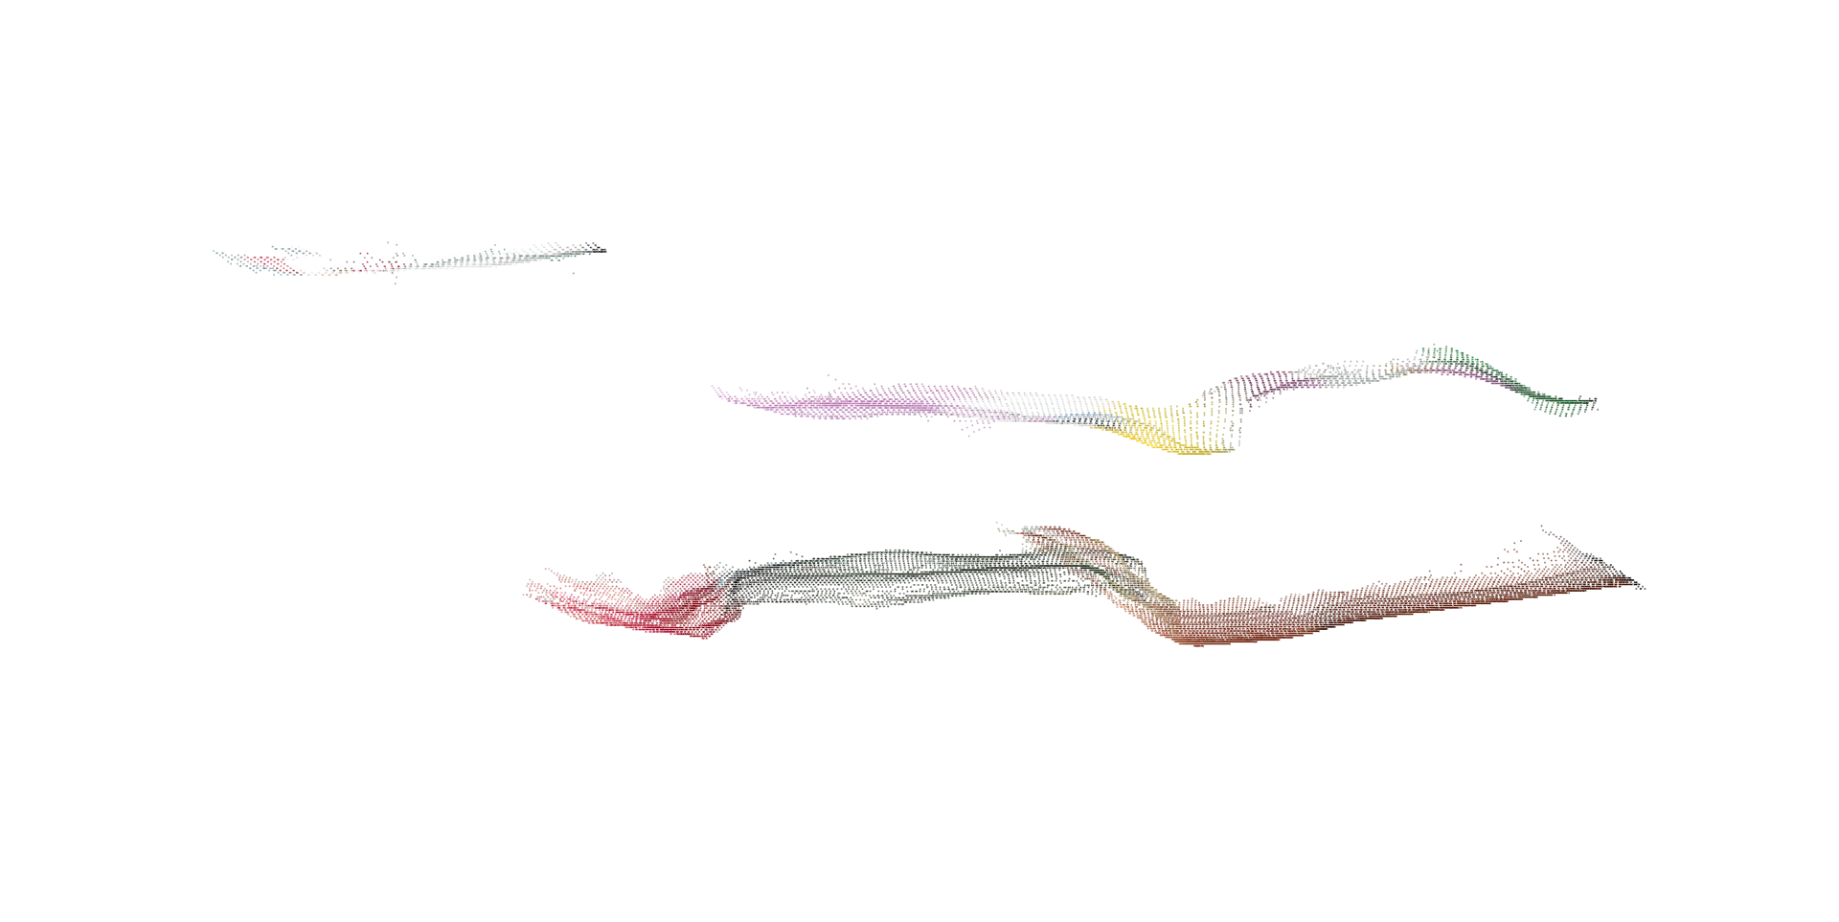

Slide 4
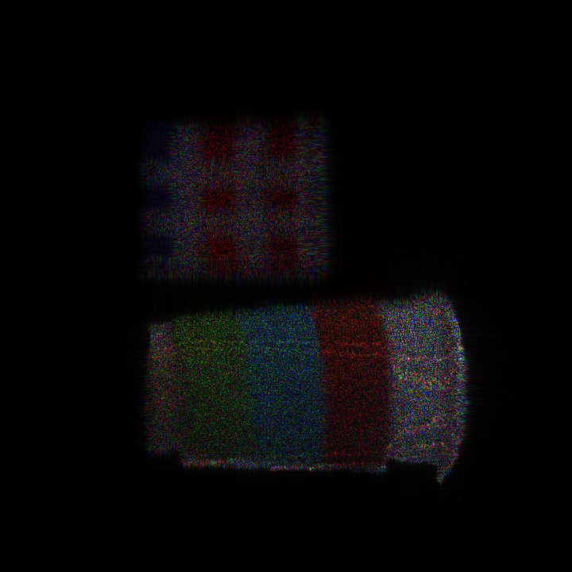
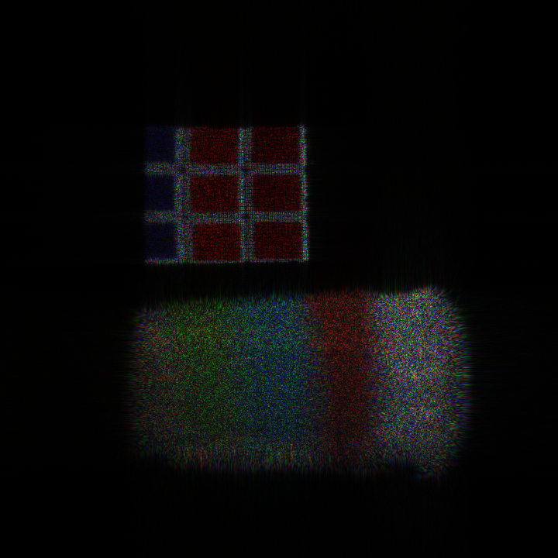
DM-WRP
Resolution: 720 X 720
Depth : 0.15
WRP:25
Cup: 0.111
Cube :0.117

Slide 5
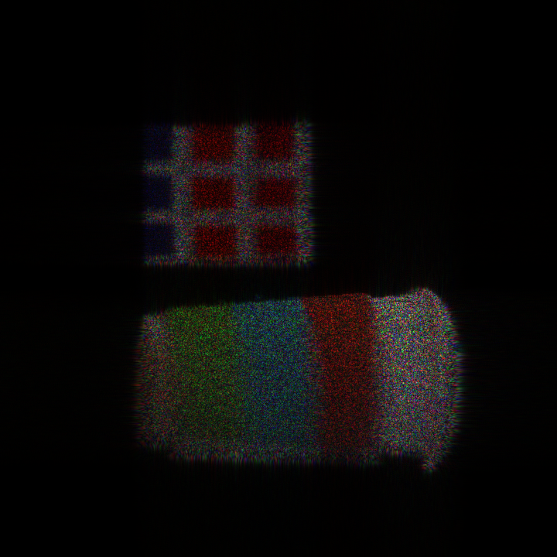
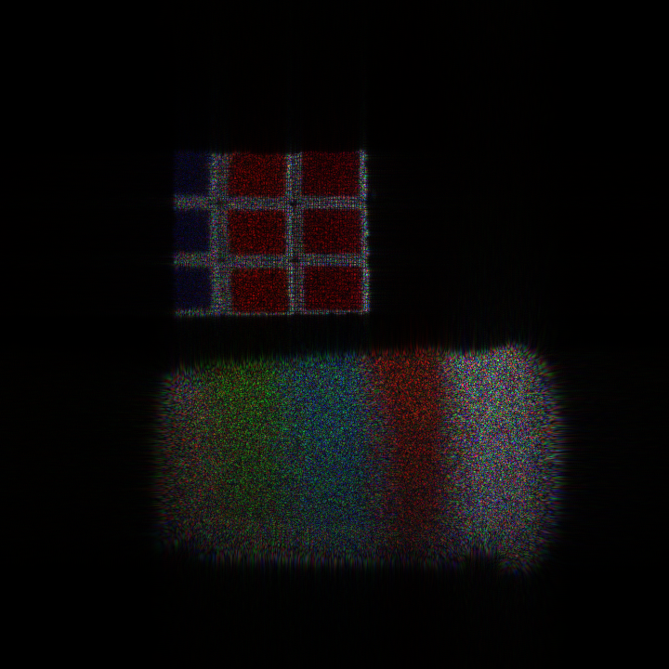
Conventional M-WRP
Resolution: 720 X 720
Depth : 0.15
WRP:29
Cup: 0.114
Cube : 0.111

Slide 6
Conventional M-WRP
Resolution: 720 X 720
Depth : 0.02037
WRP:29
Cup: 0.114
Cube : 0.111
Time: 86.8904
DM-WRP
Resolution: 720 X 720
Depth : 0.02037
Cup: 0.111
Cube :0.117
WRP:25
Time : 86.3343

Slide 7
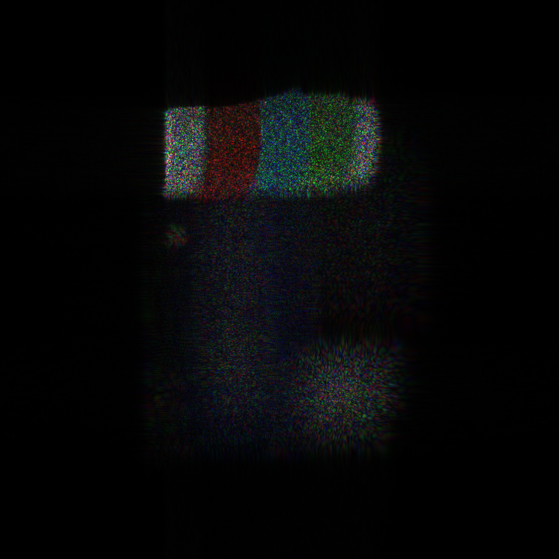
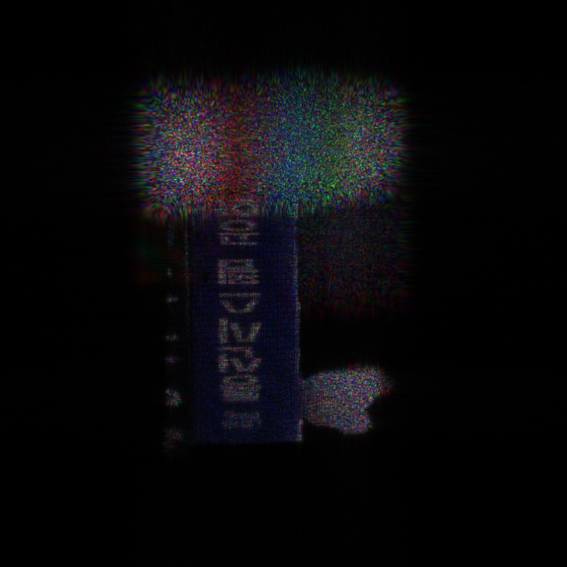
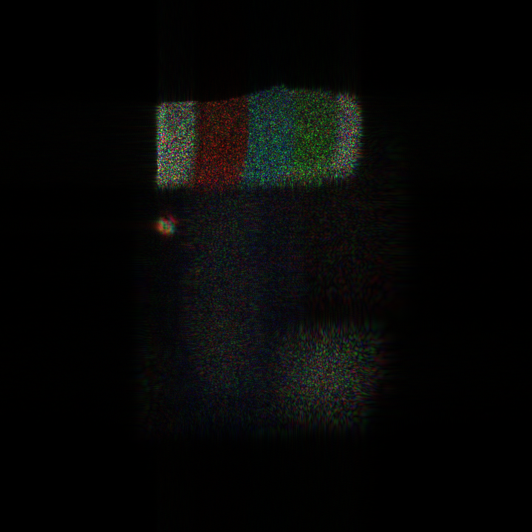
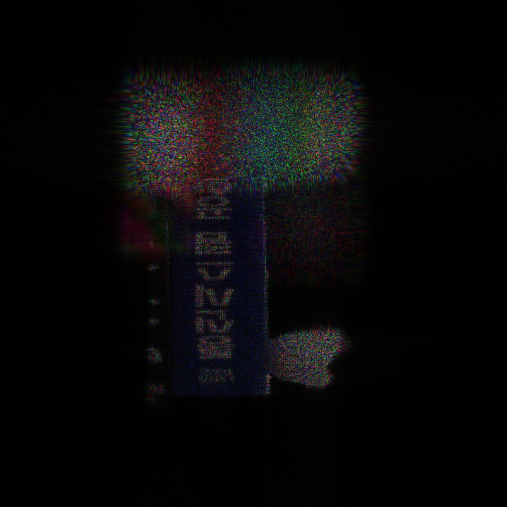
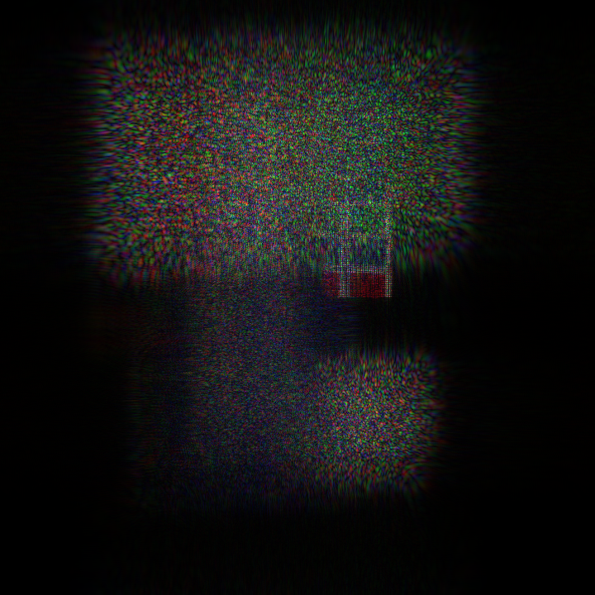
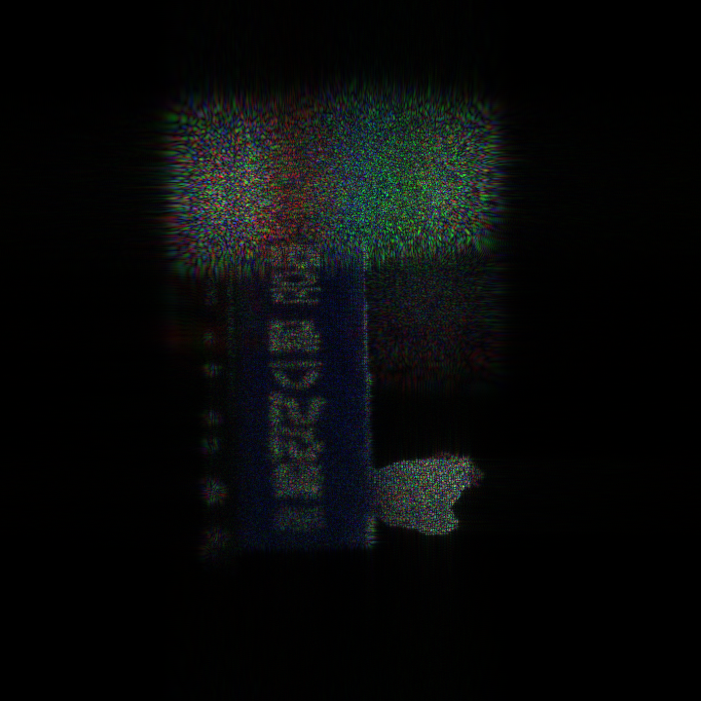
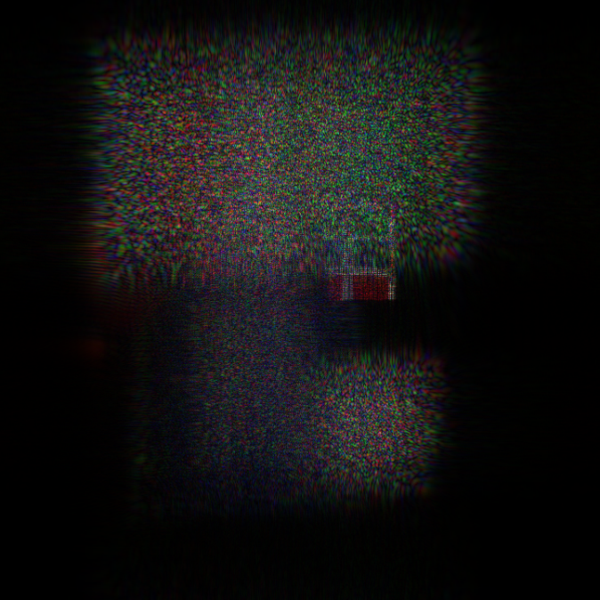
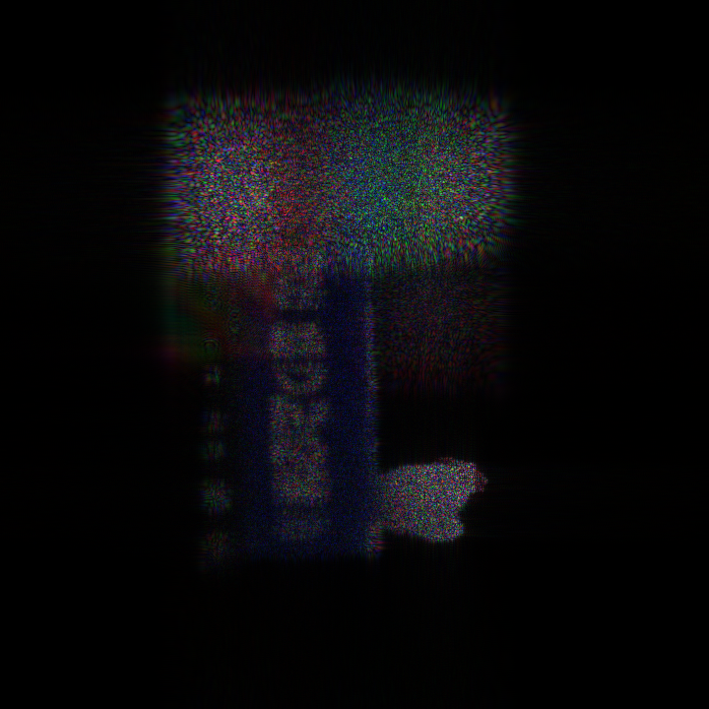
Conventional M-WRP
Resolution: 720 X 720
Depth : 0.0374
WRP:72
Cup: 0.0132
book: 0.118
cube: 0.101
Chicken:0.116
Time: 122.228429
DM-WRP
Resolution: 720 X 720
Depth : 0.0374
WRP:64
Cup: 0.0132
book: 0.1180
cube: 0.101
Chicken:0.1160
Time: 122.3459

Slide 8
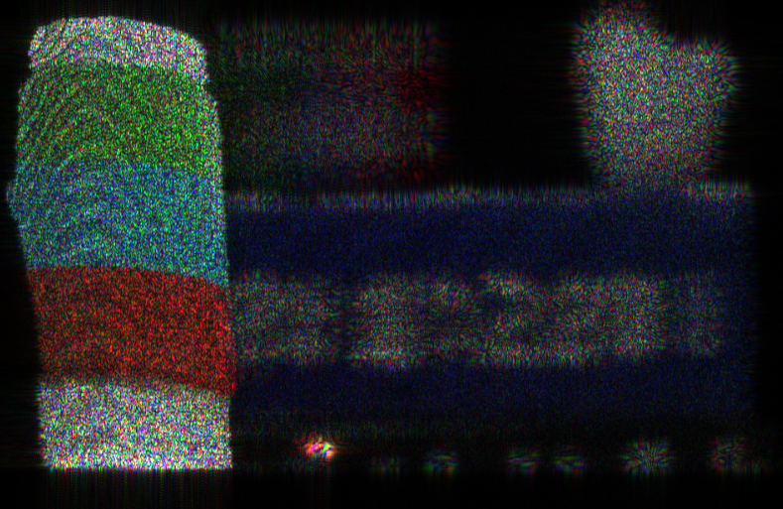
Parameters:
Resolution: 720 X 720
Depth : 0.0374
Cup: 0.0132
book: 0.1180
cube: 0.101
Chicken:0.1160
Time: 122.3459

Slide 9
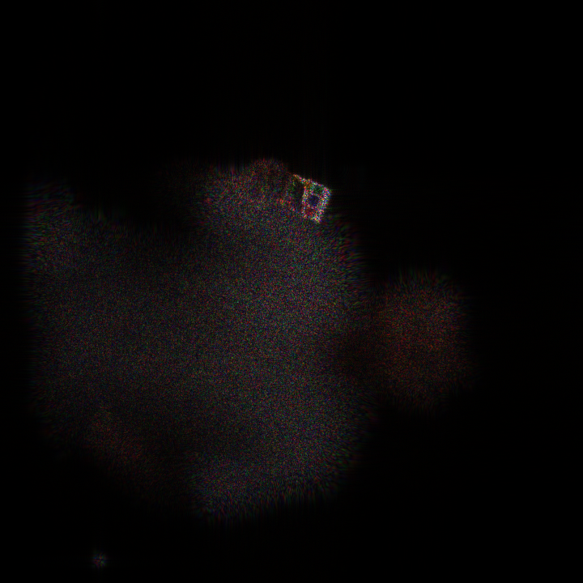
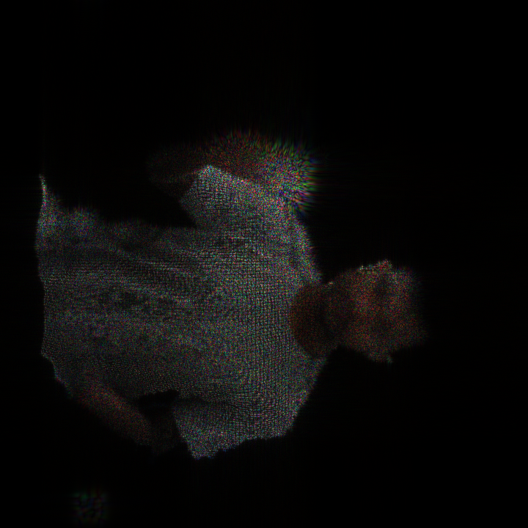
DM-WRP
Resolution: 720 X 720
Depth : 0.018346
WRP: 201
Cube:0.107
Face:0.099

